Slide 1
IOT and APPLICATIONS IS224AI-UG 4th sem 2022 scheme
Unit-II
Basics of Arduino and Raspberry Pi
Reference Book: Internet Of Things With Raspberry Pi And Arduino, Rajesh Singh, Anita Gehlot, Lovi Raj Gupta, Bhupendra Singh, and Mahendra Swain, CRC Press, Taylor & Francis Group, 2020, ISBN: 13: 978-0-367-24821-5
By,
Dr. G S Mamatha
Professor & Associate Dean(PG Studies)
Department of ISE
R V College of Engineering

Slide 2
Contents
Basics of Arduino..........................................................................................29
4.1 Introduction to Arduino.......................................................................29
4.1.1 Arduino Uno.............................................................................29
4.1.2 Arduino Mega..........................................................................30
4.1.3 Arduino Nano.......................................................................... 31
4.2 Arduino IDE...........................................................................................33
4.2.1 Steps to Install Arduino IDE..................................................33
4.3 Basic Commands for Arduino............................................................. 37
4.4 LCD Commands.................................................................................... 37
4.5 Serial Communication Commands.....................................................38
4.6 Play with LED and Arduino................................................................38
4.6.1 Sketch.........................................................................................40
4.7 Play with LCD with Arduino...............................................................40
4.7.1 Sketch.........................................................................................
Basics of Raspberry Pi..................................................................................45
5.1 Introduction to Raspberry Pi...............................................................45
5.1.1 Raspberry Pi Components......................................................45
5.2 Installation of NOOBS on SD Card.....................................................48
5.3 Installation of Raspbian on SD Card..................................................49
5.4 Terminal Commands............................................................................ 51
5.5 Installation of Libraries on Raspberry Pi........................................... 52
5.6 Getting the Static IP Address of Raspberry Pi.................................. 52
5.7 Run a Program on Raspberry Pi........................................................ 57
5.7.1 Editing rc.local........................................................................ 57
5.8 Installing the Remote Desktop Server..............................................58

Slide 3
Basics of Arduino
Arduino was invented at the Ivrea Interaction Design Institute
It was designed for fast prototyping, targeting the hobbyist without any programming background.
Arduino boards are completely open source and can be used for application development with particular requirements.
The Arduino software is user-friendly and easy to begin with a flexible environment for advanced users.
It can be operated on Mac, Linux, and Window platforms.
New things can be learned with Arduino.

Slide 4
Advantages of Arduino
Cost: Arduino boards are less expensive compared to other microcontroller boards.
Platform: The Arduino Software (IDE) is compatible with most of the operating systems like Macintosh OSX, Windows, and Linux.
User friendly: The Arduino Software (IDE) is user-friendly, easy to begin, and has flexibility for the skilled programmers.
Open source: The Arduino is an open-source software that can be programmed with C, C++, or AVR-C languages. So a variety of modules can be designed by users.

Slide 5
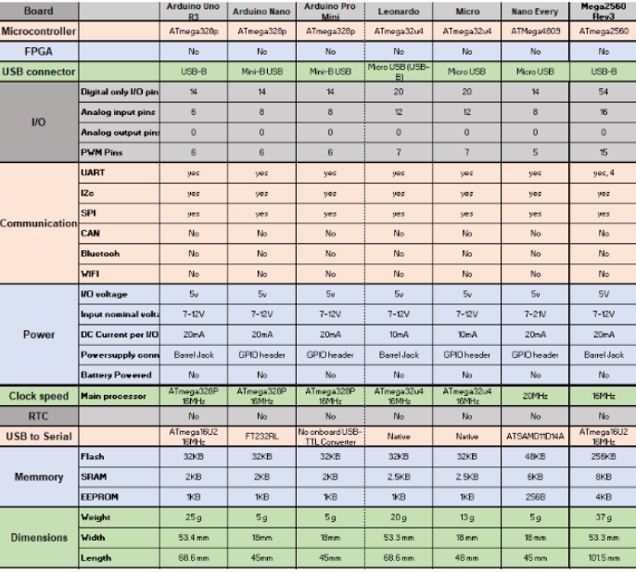

Slide 6
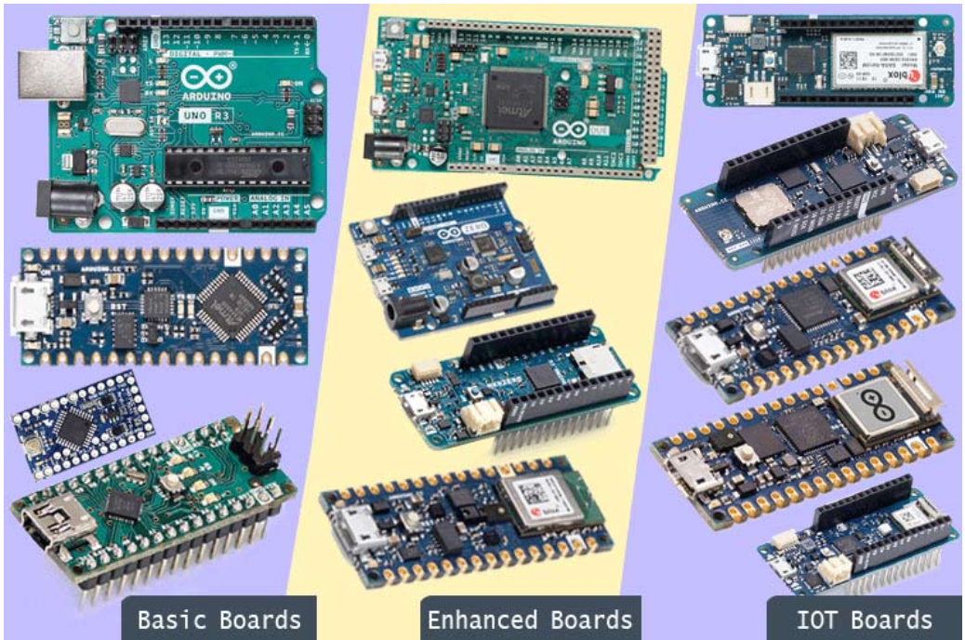
Arduino board types

Slide 7
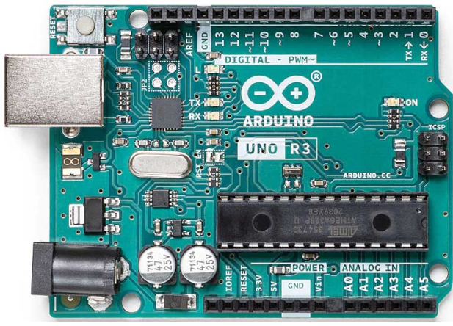
Arduino UNO R3
Arduino Uno is the most popular and widely used development board.
It is powered by an ATMega328P microcontroller.
Cheaper, easy to learn and use, and also a variety of premade modules are available for this which makes it easier for developing new projects or prototypes.
It consists of 14 Digital I/O, out of which 6 pins are 8 bit PWM pins, 6 pins are 10-bit Analog inputs, and basic communication ports like SPI, I2C, and UART.
Each pin can operate on 0–5 V of voltage.
It operates at 16 MHz of frequency.

Slide 8
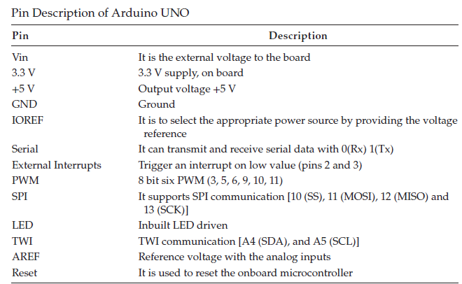
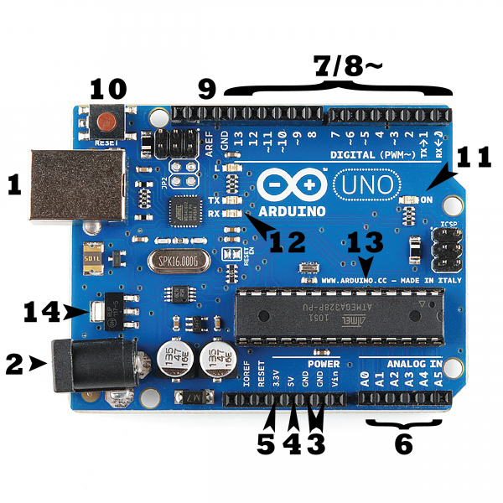

Slide 9
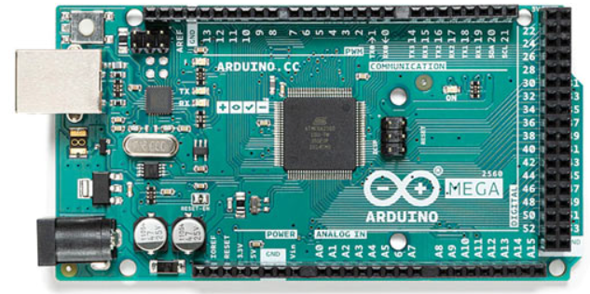
Arduino Mega 2560
Arduino Mega 2560 is the biggest of all the boards.
It is designed for applications where a lot of I/O or peripherals are needed.
It is powered by a bigger and more capable processor the ATMega2560.
This board has the greatest number of I/O than most other boards, 54 I/O pins (of which 15 can be used as PWM outputs), 16 analog inputs, and 4 UARTs.
It has more flash storage and SRAM than most other basic Arduino boards.
It is most popular with the opensource CNC and 3D printer community as well as the opensource PLC community.

Slide 10
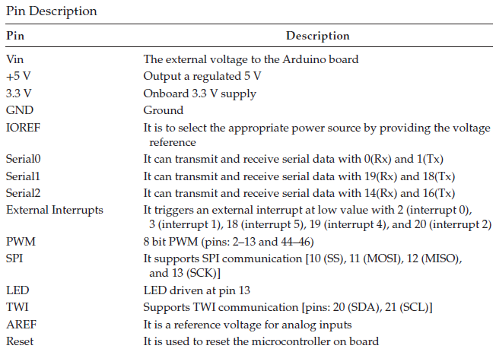
Arduino Mega

Slide 11
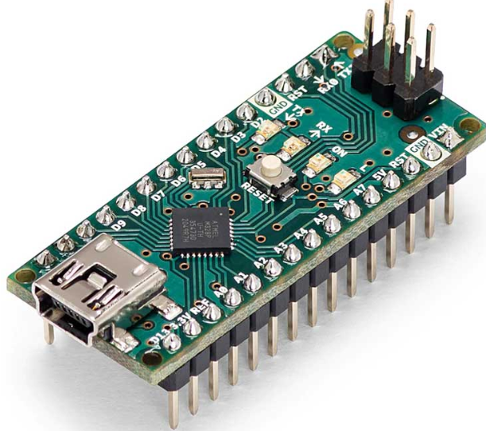
Arduino Nano
Arduino Nano is a small breadboard-friendly version of Arduino UNO.
It has more or less functionality of the Arduino UNO but in a small form factor.
The only major differences from UNO are the lack of a DC power jack, the usage of a Mini USB port instead of a USB B port, and the USB-TTL converter chip.
Nano uses an FT232, a dedicated USB-UART bridge chip from FTDI instead of an ATMega16U2.
It is also a very popular choice among the developers just like UNO because of its small size and cheap price.
The Arduino/Genuino Nano has an onboard ATmega328 microcontroller.
It has 8 analog inputs, 14 digital I/O ports, and 6 PWM. It has onboard 32 KB flash memory, 1 KB EEPROM, 2 KB SRAM, and operates at 16 MHz of frequency.

Slide 12
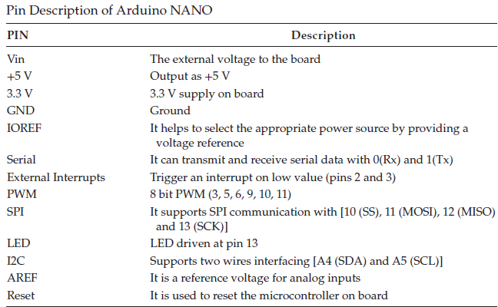
Arduino Nano

Slide 13
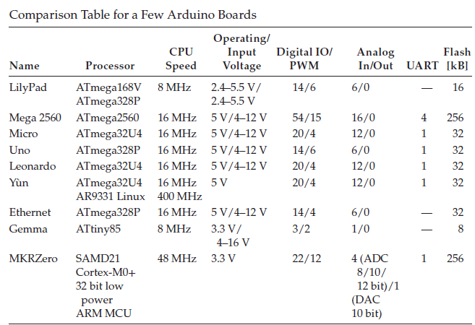
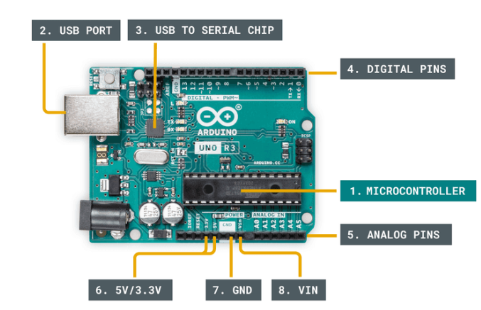
Comparison Table for a Few Arduino Boards

Slide 14
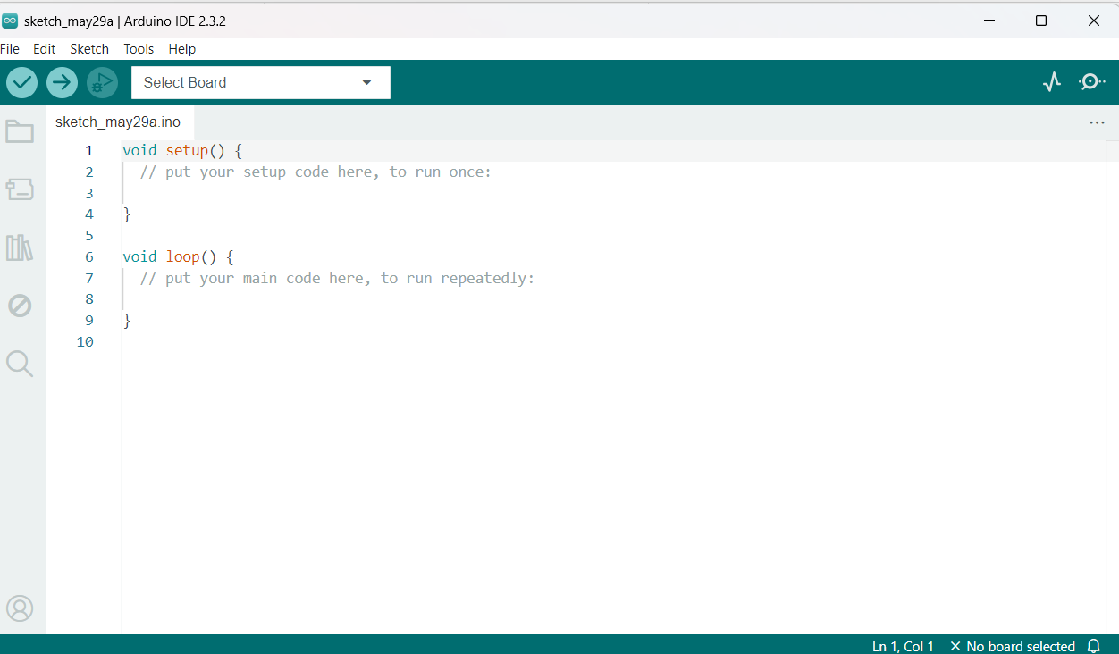
Arduino IDE
The Arduino integrated development environment (IDE) is an open-source software, and it makes it easy to write code and upload it to the board.
Steps to Install Arduino IDE:
Step 1: Install Arduino IDE and open the window: To begin, install the Arduino IDE.
Step 2: Choose the version of Arduino board
Arduino has many versions like UNO, MEGA, NANO, etc.
Before starting the project, find out the suitable version by selecting the parameters according to the requirement.
The most common board for beginners is the Arduino UNO.

Slide 15
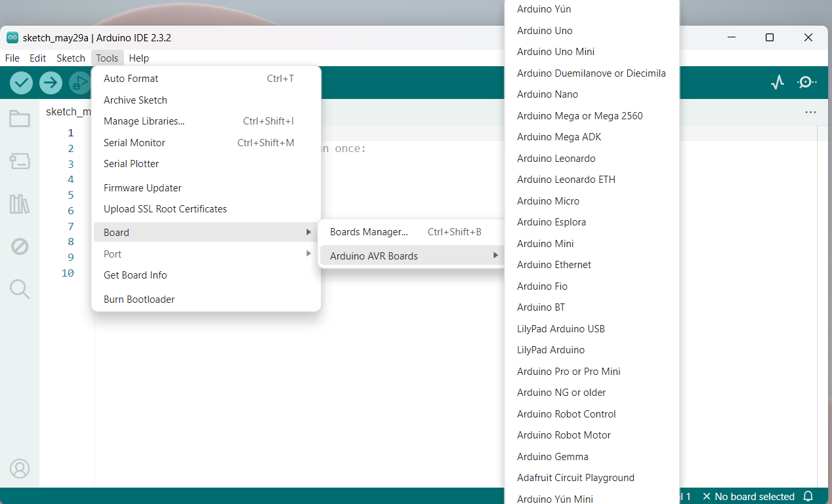
Selection of Arduino board.

Slide 16
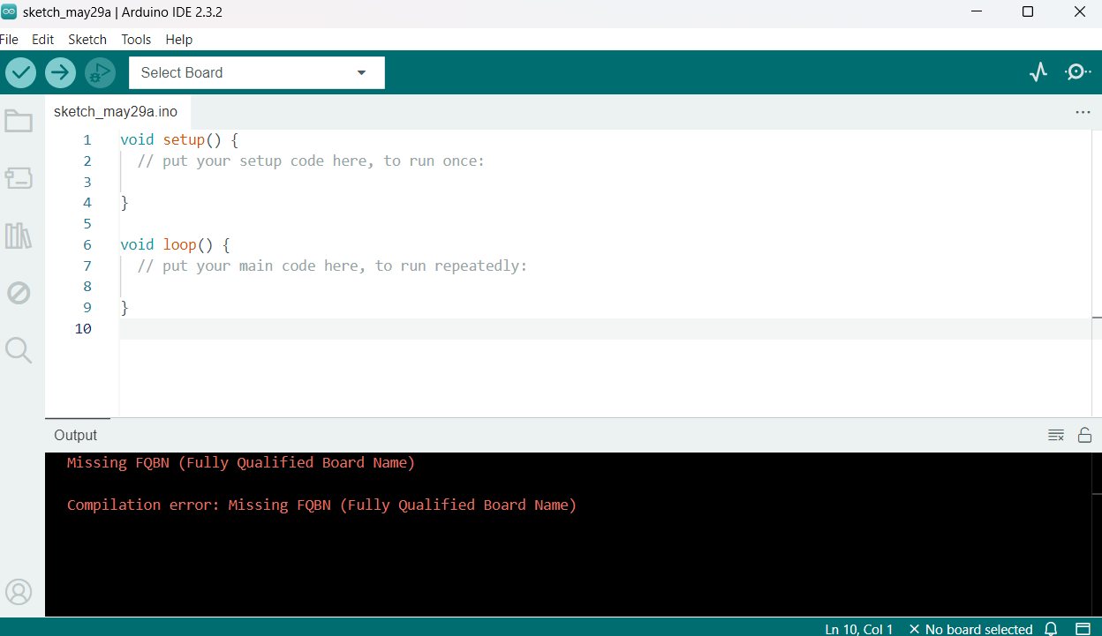
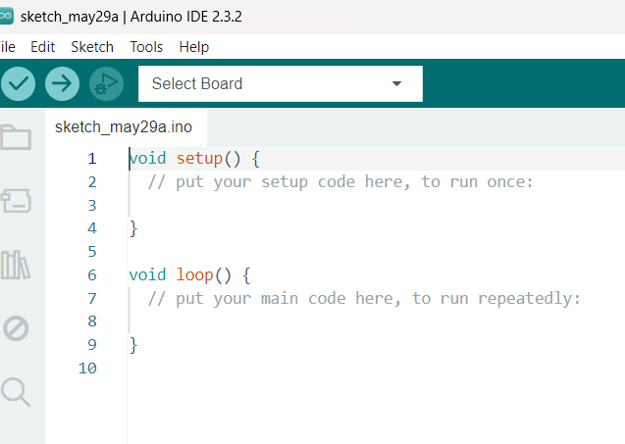
Step 3: Write and compile the program
Write the program in the Arduino IDE window. Then “RUN” the program.
Below shows the window to compile the program.

Slide 17
Step 4: Connect Arduino with PC
Connect Arduino to the USB port of the PC with a USB cable.
Every Arduino board has a different serial-port address (COM2, COM4, etc.), so it is required to reconfigure the port for each Arduino and select it in IDE.
To check the port at which the Arduino is connected, right click on “PC” then select “manager”; a window will open.
Then double click on “Device Manager.” A window will open. Click on ports COM and LPT and port at which device is connected can be found.
Now click on the “Tool” head at the Arduino IDE window.
Go to the port and select the same port number, which is found in the device manager (select COM1 or COM2, etc).
Step 5: Upload program to Arduino board
Upload the program to the Arduino board.

Slide 18
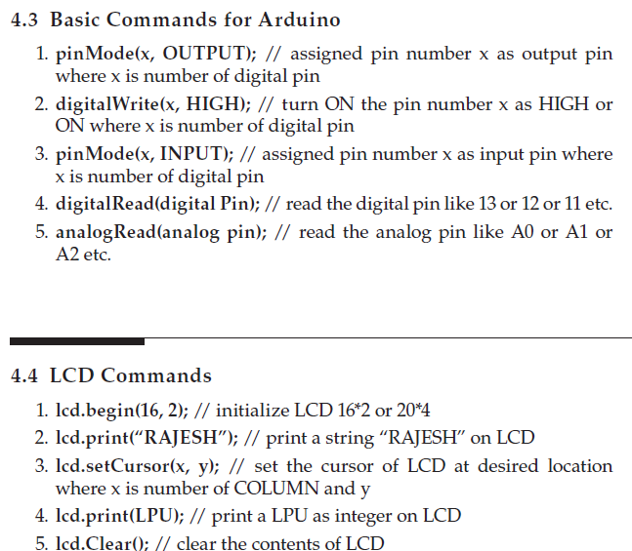
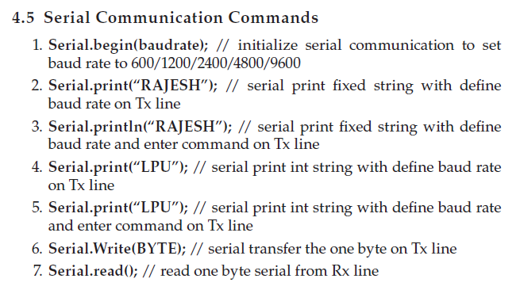

Slide 19
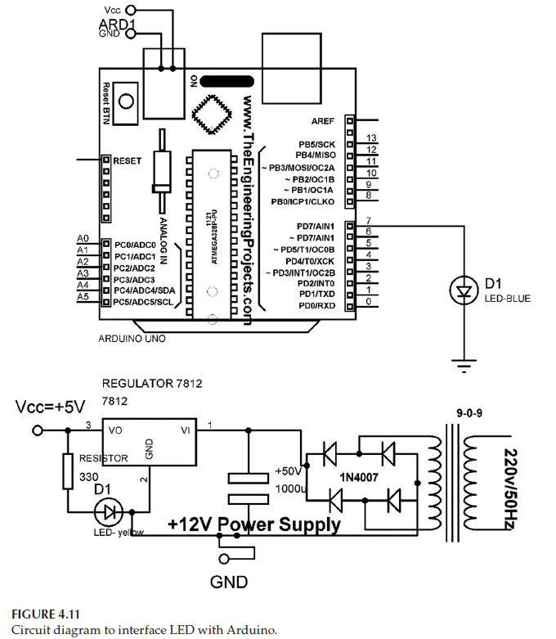
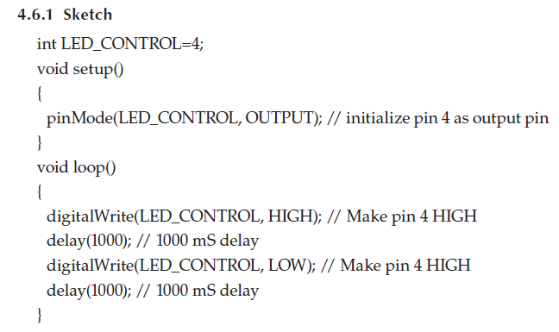
Play with LED and Arduino
A light-emitting diode (LED) is a device
that can be used as an indicator.
An LED has two terminals, anode and cathode.
LEDs are available in a different colors
Different colors can be used to represent
different conditions.

Slide 20
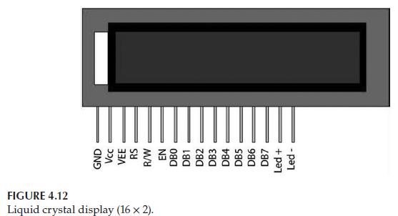
Play with LCD with Arduino
The liquid crystal display (LCD) is a commonly used display module.
A 16 × 2 LCD display is used as a display device in the circuits. This module is preferred over seven segments because they have no limitation of displaying special, and even custom, characters and are economical.
A 16 × 2 LCD can display 16 characters per row, and there are 2 rows.
In this LCD, the 5 × 4 pixel matrix displays the character. It has two registers, namely, data register and command register.
A 20 × 4 LCD has 4 rows and can display 20 characters per row. A 5 × 4 pixel matrix is used to display characters. Pin description is the same as LCD (16 × 2).

Slide 21
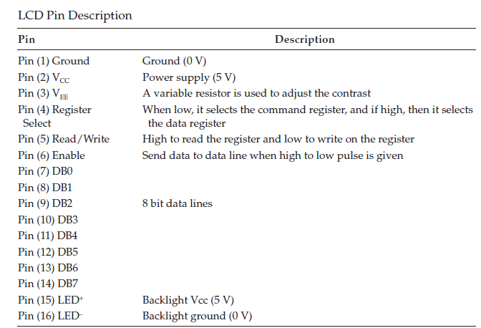
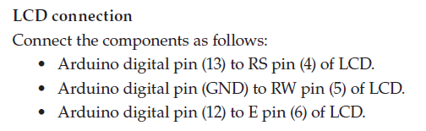
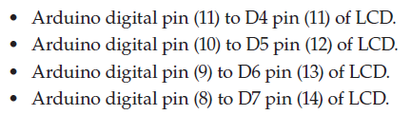

Slide 22
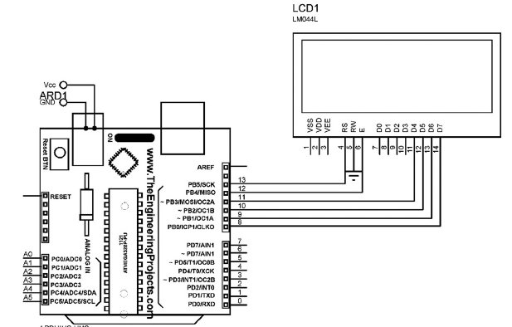
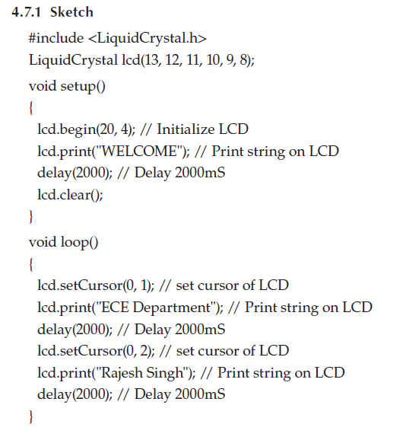
The heart of an LCD is a special liquid that is called a twisted nematic liquid crystal. This liquid has the capability of rotating the polarization of linearly polarized light.

Slide 23
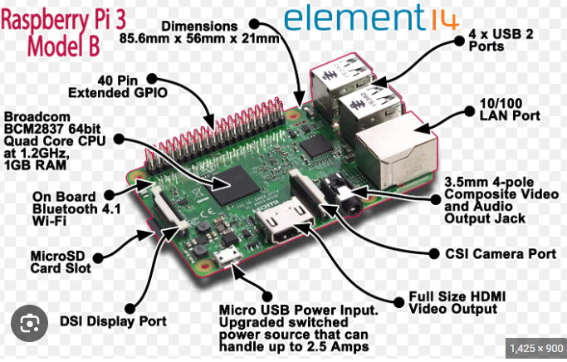
Basics of Raspberry Pi
Raspberry Pi is a low-cost mini-computer that can be connected to a computer monitor or TV.
It is a device for exploring the computer computing with the help of a keyboard and mouse.
A few optional parts can be connected with it for better accessibility.
It can be programmed in languages like Scratch and Python.
The processor frequency ranges from 700 MHz to 1.4 GHz for the Pi 3 model B+.
The onboard memory ranges from 256 MB to 1 GB RAM.
Raspberry Pi 3+ has a 1.4 GHz 64-bit quad core ARM cortex A53 processor.

Slide 24
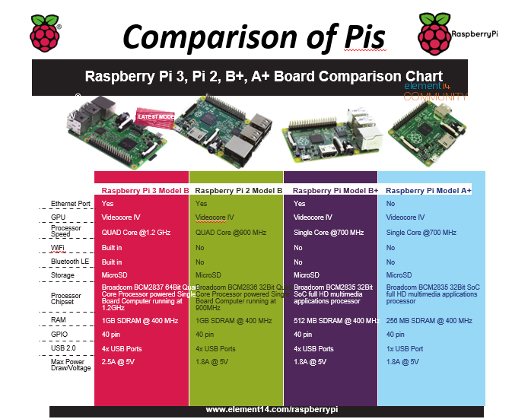

Slide 25
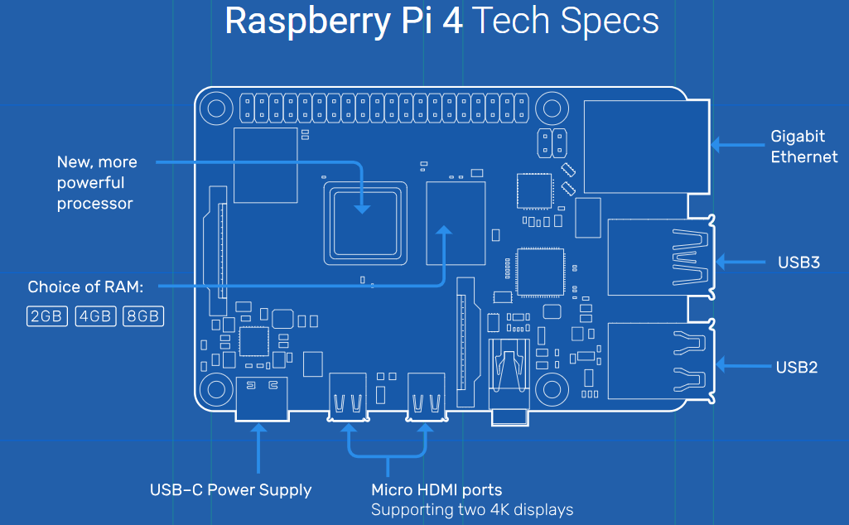
Raspberry Pi 4

Slide 26
Broadcom BCM2711, Quad core Cortex-A72 (ARM v8) 64-bit SoC @ 1.8GHz
1GB, 2GB, 4GB or 8GB LPDDR4-3200 SDRAM (depending on model)
2.4 GHz and 5.0 GHz IEEE 802.11ac wireless, Bluetooth 5.0, BLE
Gigabit Ethernet
2 USB 3.0 ports; 2 USB 2.0 ports.
Raspberry Pi standard 40 pin GPIO header (fully backwards compatible with previous boards)
2 × micro-HDMI® ports (up to 4kp60 supported)
2-lane MIPI DSI display port //Mobile Industry Processor Interface Display Serial Interface
2-lane MIPI CSI camera port // camera serial interface
4-pole stereo audio and composite video port
H.265 (4kp60 decode), H264 (1080p60 decode, 1080p30 encode)
OpenGL ES 3.1, Vulkan 1.0
Micro-SD card slot for loading operating system and data storage
5V DC via USB-C connector (minimum 3A*)
5V DC via GPIO header (minimum 3A*)
Power over Ethernet (PoE) enabled (requires separate PoE HAT)
Operating temperature: 0 – 50 degrees C ambient
* A good quality 2.5A power supply can be used if downstream USB peripherals consume less than 500mA in total.

Slide 27
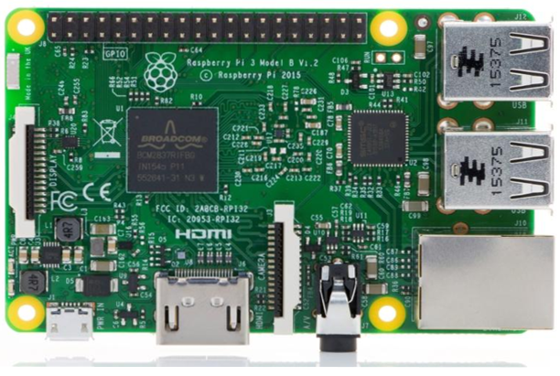
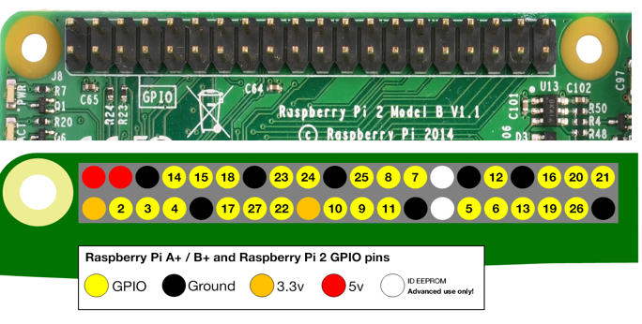
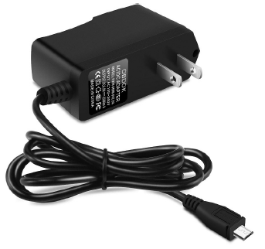
Raspberry Pi Components
Power supply: The Raspberry Pi can be powered with a micro-USB connection capable of supplying at least 400 mA at 5 V; standard mobile phone chargers are suitable for this purpose.
If Raspberry Pi is powered up from a USB port of another computer, it may not supply the required current.

Slide 28
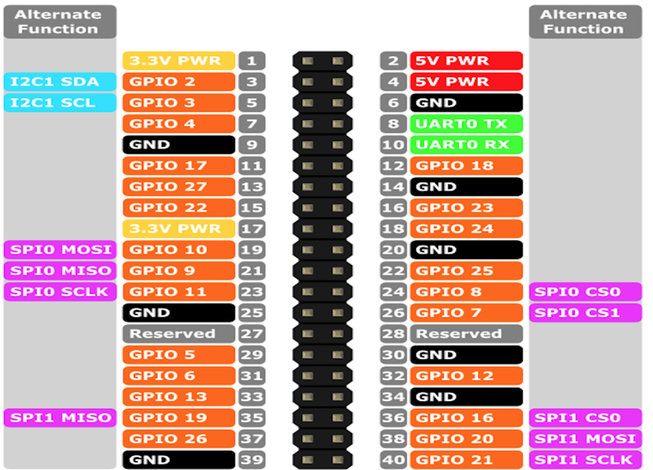
24-GPIO pins
GND- 8 pins
VCC- 4 pins
I/O board - 26 pins
Reading hardware monitors, sensors, real-time clocks, controlling actuators,
UART stands for universal asynchronous receiver / transmitter and defines a protocol, or set of rules, for exchanging serial data between two devices.
The serial peripheral interface (SPI) is a communication interface used to send data between multiple devices. These devices are organized into a master and slave configuration, in which the master has control over the slaves and the slaves receive instruction from the master.

Slide 29

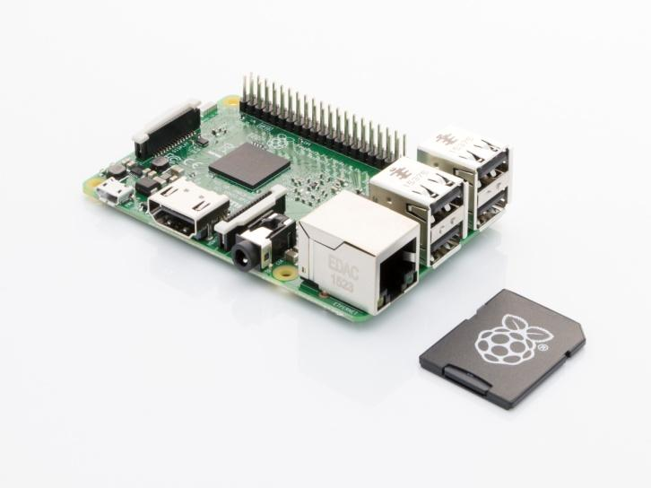
Software Installation on Pi
Use NOOBS (New Out Of the Box Software) installation manager for installation of RASPBIAN OS on Pi board.
Unless you have a pre-installed microSD card with NOOBS ready to insert into your
Pi, installing an operating system requires a Windows, Mac or \Linux computer.

Slide 30
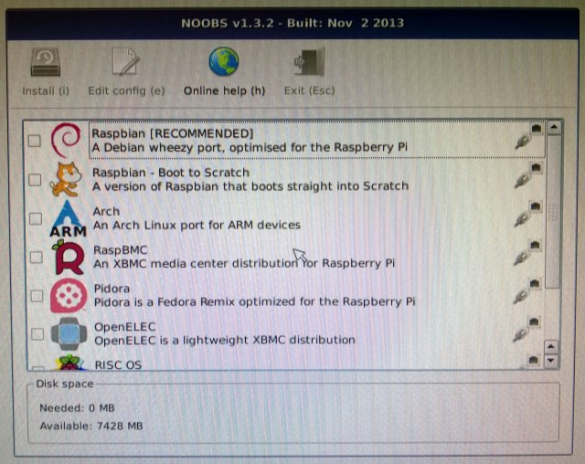

Slide 31


Remote Connectivity
-Install VNC Viewer in your Windows System/PC
https://www.realvnc.com/en/connect/download/viewer/windows/
-Install VNC server in Raspberry Pi
https://www.realvnc.com/en/connect/download/viewer/raspberrypi/
-Install Putty software for remote connectivity in Windows PC
https://www.putty.org/
Use arp –a command in CLI of Pi to obtain the IP address of Pi.

Slide 32
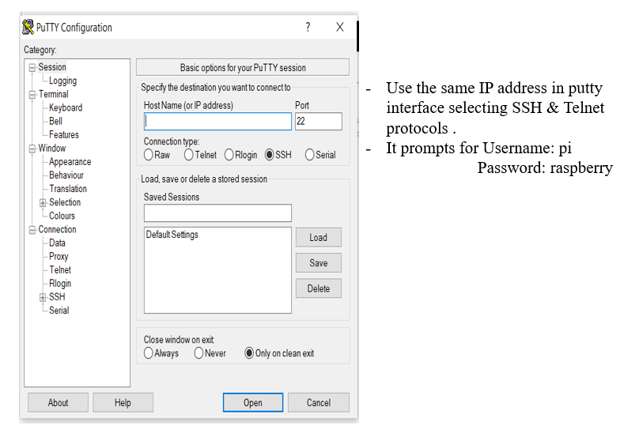
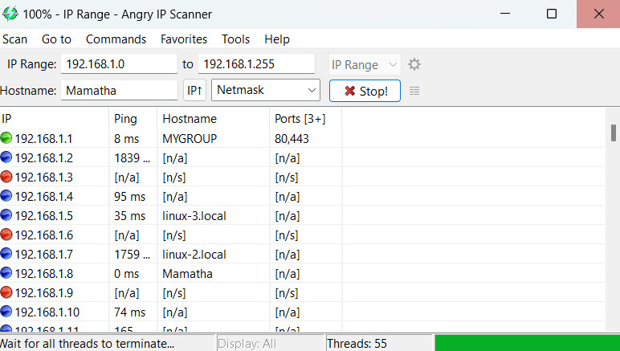
Angry IP scanner is a very fast IP address and port scanner.

Slide 33
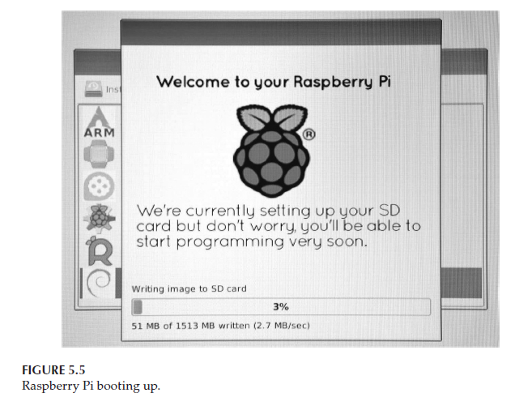
Raspberry pi Desktop view

Slide 34
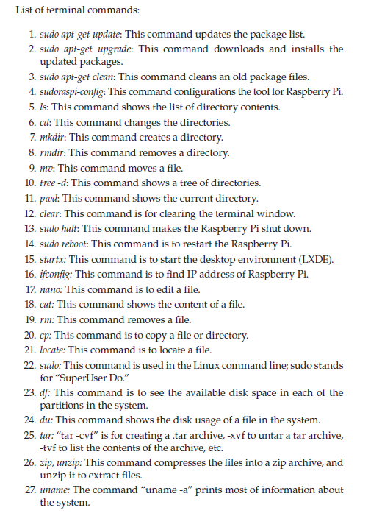
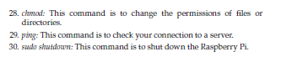

Slide 35
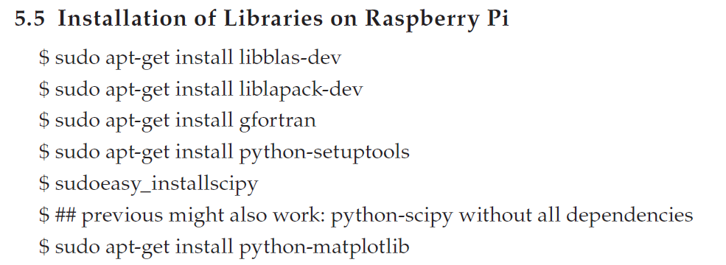
BLAS (Basic Linear Algebra Subroutines) is a set of efficient routines for most of the basic vector and matrix operations.
LAPACK version 3.X is a comprehensive FORTRAN library that does linear algebra operations including matrix inversions, least squared solutions
Gcc compiler collection –gfortran
setuptools allows you to install a package without copying any files to your interpreter directory (e.g. the site-packages directory).
SciPy provides algorithms for optimization, integration, interpolation, eigenvalue problems, algebraic equations, differential equations ...
Matplotlib is a comprehensive library for creating static, animated, and interactive visualizations in Python.

Slide 36
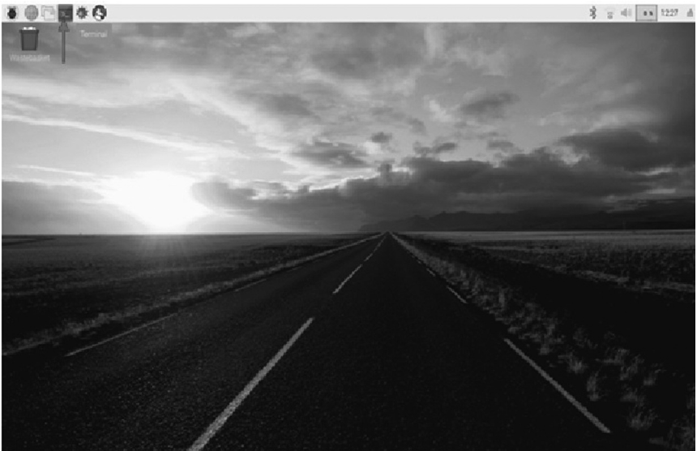
Getting the Static IP Address of Raspberry Pi
Raspberry Pi gives a different IP address.
Each time it gets “ON,” this IP is known as current IP address.
So each time, user needs to check for its IP.
To avoid this problem, a static IP address needs to be created, which will not change in turning “OFF” the device.
Steps to create a static IP address:
Open the terminal window in pi. 2. At the command line, write the command “ifconfig” (This command gives network-related information. This shows the current IP address; here it is IP address of device.
3.
Open the configuration file.
Now open the configuration file where a static IP address can
be configured.
The filename is dhcpcd.conf, and it is stored in the folder named etc.
To make any change, use the nano editor in the terminal window with the help of the command: “sudonano /etc/dhcpcd.conf” .
After this command, a window will open .
In the screen, scroll down until you see: “# Example static IP configuration”.

Slide 37
Now remove “#” from each line of this paragraph and change the last figures of the IP address from a range of 1 to 255 .
Once changes are made, exit the window by using Ctrl+x and save the changes by click on “Yes” .
Reboot the Raspberry Pi by the command “reboot”.
Check the static IP address of Raspberry by the command “ifconfig”.

Slide 38
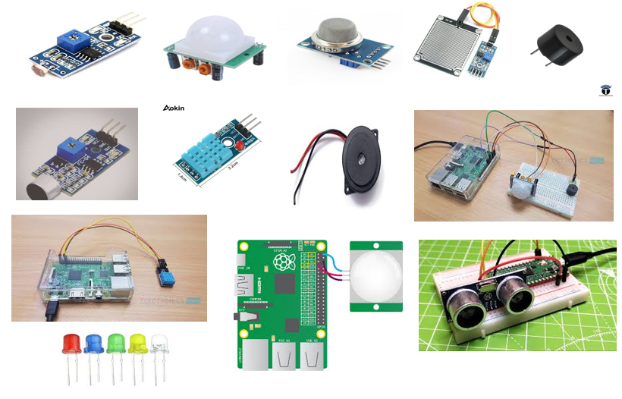
Sensors

